Slide 1
Automated Phissing Email Detection and Reporting System
Supervised by:
Eng .Taghreed Salem

Slide 2
Table of Contents
Introduction
Motivation
System Overview
Similar Systems
What Makes Our System Unique?

Slide 3
Introduction

Slide 4
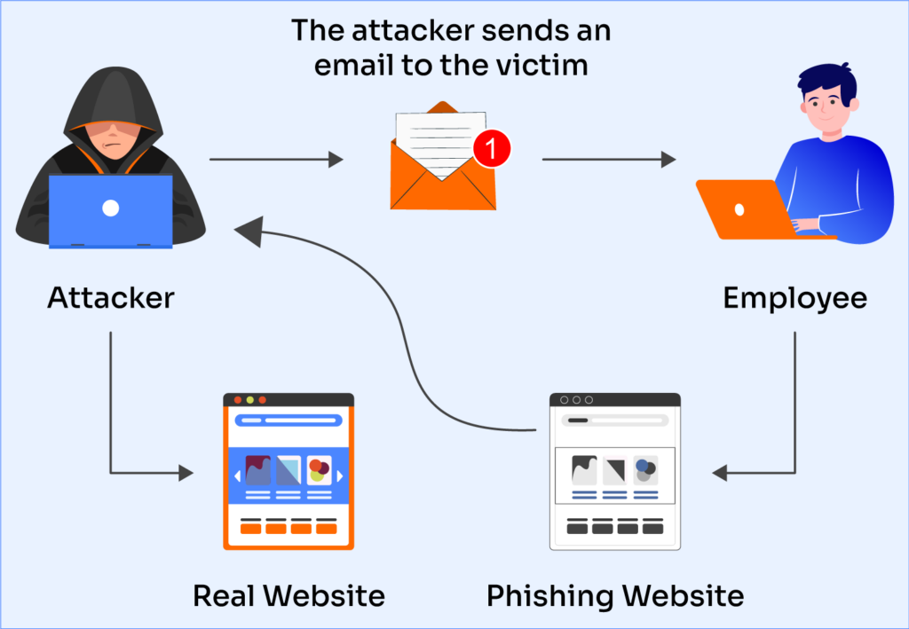
Problem Statement
Phishing is a cyber attack where attackers trick users into giving their sensitive information.
Attackers send fake emails, messages, or links that look real
They pretend to be banks, companies, or trusted organizations
Victims are asked to click a link or enter login details

Slide 5
Problem Statement (cont.)
Phishing attacks target anyone who uses email or online services, including:
Individuals (regular users)
Employees in companies
Businesses and organizations
Banks and financial institutions
Students and universities
This can cause financial loss, steal passwords and personal data, or disrupting organizations systems.

Slide 6

Objectives
Implementing a phishing email detection system
A phishing email detection system helps identify and block phishing emails before they reach users.
Uses machine learning and security rules to analyze emails
Detects suspicious links, fake senders, and unusual content
Classifies emails as Phishing or Safe
Warns users or automatically blocks malicious emails

Slide 7
Project Idea
Classify emails as Safe or Phishing using content and header of the mail.
Use a hybrid approach combining:
Machine Learning
NLP techniques
Rule-based URL and header checks
Apply TF-IDF for feature extraction from email text.

Slide 8
Project Idea (cont.)
Use classical ML algorithms (Logistic Regression, Naive Bayes, SVM, Random Forest).
Implement a multi-stage detection engine to improve accuracy and robustness.
Provide real-time results with confidence scores and explanations.
Offer a web-based interface with persistent scan logging.
Deliver a practical and efficient phishing detection solution.

Slide 9
Project Motivation

Slide 10
Scientific Perspective
Research Gaps Addressed
Limited use of hybrid detection approaches combining machine learning with rule-based analysis.
Lack of explain ability in many phishing detection systems, reducing trust and usability.
Poor generalization to unseen, real-world emails due to overfitting on benchmark datasets.

Slide 11
Scientific Perspective
Scientific Support & Relevant Studies
Research shows that TF-IDF combined with classical ML algorithms (SVM, Random Forest, Logistic Regression) performs effectively in phishing detection.
Studies confirm that URL-based lexical features significantly improve phishing detection accuracy.

Slide 12
Scientific Perspective
Literature reviews highlight that hybrid systems outperform single-technique models in handling evolving phishing strategies.
Existing research emphasizes the need for lightweight, interpretable, and deployable phishing detection systems for practical use.

Slide 13
Market Perspective
Market Demand & Trends
Rapid growth in phishing and social engineering attacks.
Increasing use of AI-generated phishing emails.
High demand for affordable and easy-to-deploy email security solutions.
Growing interest in explainable cybersecurity systems.
Impact & Benefits
Reduces phishing-related risks and losses.
Improves user awareness and trust.
Provides real-time, transparent email protection.
Suitable for organizations, universities, and individuals.

Slide 14
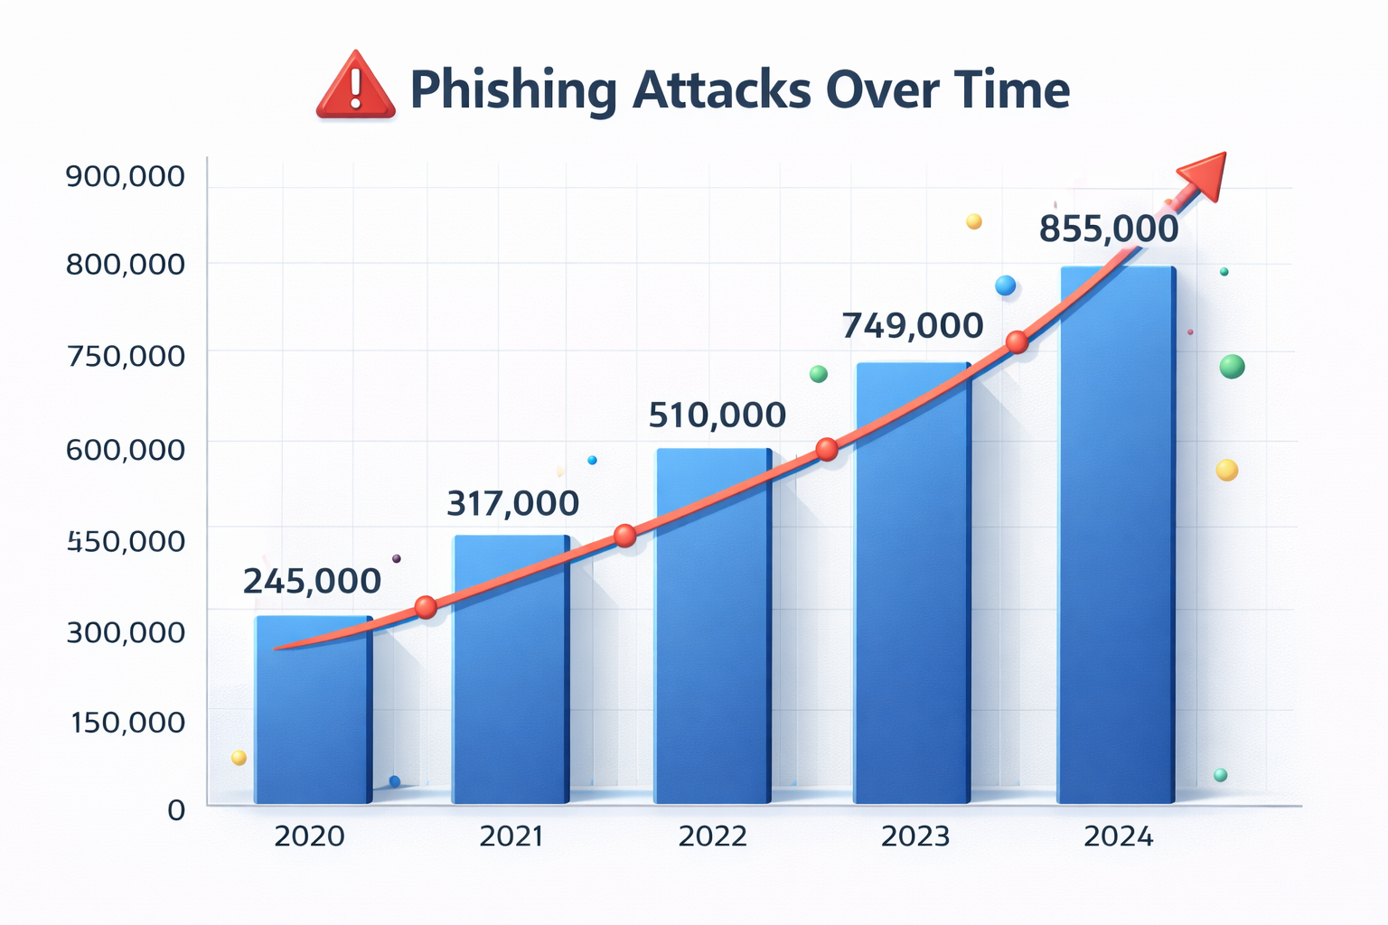
Market Perspective
FBI IC3 Reports & APWG Phishing Trends (2020–2024)

Slide 15
System Overview Diagram

Slide 16
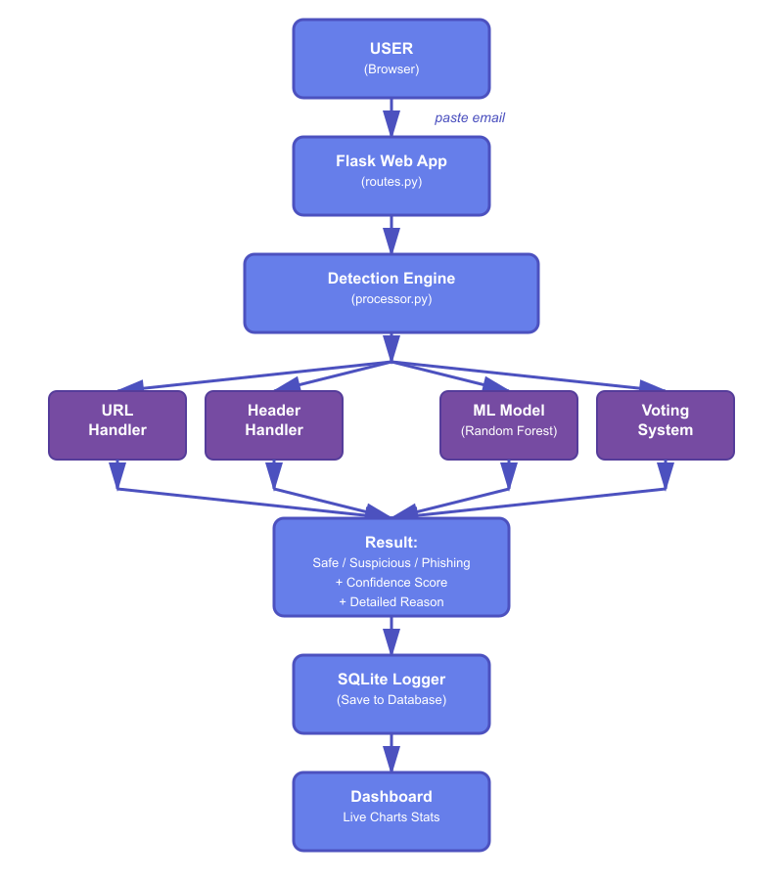
System Overview

Slide 17
Similar Systems

Slide 18
Similar systems “comparative studies”
System | Release / Major Update | Detection Accuracy* | Key Approach | Limitations
Barracuda Email Protection [reference number] | Active AI upgrades (2023–2025) | ~99.2% | ML + behavior analysis | Limited explainability, closed system
Microsoft Defender for Office 365 [reference number] | Rebranded 2020, continuous updates | ~89–98% | ML + reputation + policies | Weaker against advanced impersonation
Mimecast Email Security [reference number] | Cloud Integrated expansion (2023) | ~99% (overall email security) | Multi-layer AI filtering | Expensive, complex tuning

Slide 19
Barracuda Sentinel / Barracuda Email Protection(2023)
Type: AI-powered email security platform used widely by enterprises(99.2%).
Real-World Use: Trusted by many businesses for proactive protection and automated quarantining.
Strengths:
AI pattern learning for internal and external threats
Real-time automated remediation
Protects against impersonation and account takeover
Limitations:
Largely tailored for enterprise environments
May require subscription and configuration
Might not deeply explain why an email is flagged (visibility is mainly internal)

Slide 20
Microsoft Defender for Office 365 (2021)
Type: Built-in malware and phishing protection for Microsoft 365 customers(89 – 98 %).
Real-World Use: Extensively used by organizations that rely on Microsoft 365, from SMBs to enterprises.
Strengths:
Seamless with Microsoft products
Automated link/attachment scanning
Limitations:
Real users report gaps in advanced spoofing and display-name attacks.
Often needs additional layers to fully protect against modern phishing.

Slide 21
Mimecast Email Security(2023)
Type: Cloud-based enterprise email security solution(~98%).
Real-World Use: Commonly deployed in midsize to large businesses.
Strengths:
Multi-layered detection (URLs, attachments, content)
Integrated awareness training
Strong dashboard and reporting
Limitations:
Typically more expensive than basic email protection
Requires some expertise to tune correctly

Slide 22
What Makes Our System Unique?
Explainable: Provides clear reasons why an email is classified as phishing
Detects suspicious URLs and phishing links within emails
Trained and tested on public benchmark datasets
Can be adapted to different organizations
Key Takeaway:-
Our system prioritizes transparency, URL-based threat detection, and adaptability — addressing major limitations of current commercial phishing detection solutions.

Slide 23
Technical Approach

Slide 24
Rule-Based Detection Layer (Chain of Responsibility)
HeaderHandler
Parses email headers
Validates sender format
Detects:
Missing or malformed sender
Suspicious domains & TLDs
Brand impersonation (PayPal, Amazon, Google, etc.)
Obfuscated or nested domains

Slide 25
Rule-Based Detection Layer (Chain of Responsibility)
URLHandler:
Extracts URL-based features from email body
Detects:
Long URLs
IP-based links
URL shorteners
Suspicious TLDs
Excessive symbols & uppercase
Computes a risk score
Immediately flags high-risk phishing emails
These layer quickly blocks obvious phishing attempts without using ML, improving speed and reliability.

Slide 26
Ensemble Learning Model Architecture
Main idea:
Multiple specialized models analyze the same email
Each model focuses on different phishing signals
A meta-classifier combines their predictions
Results in higher accuracy and robustness

Slide 27
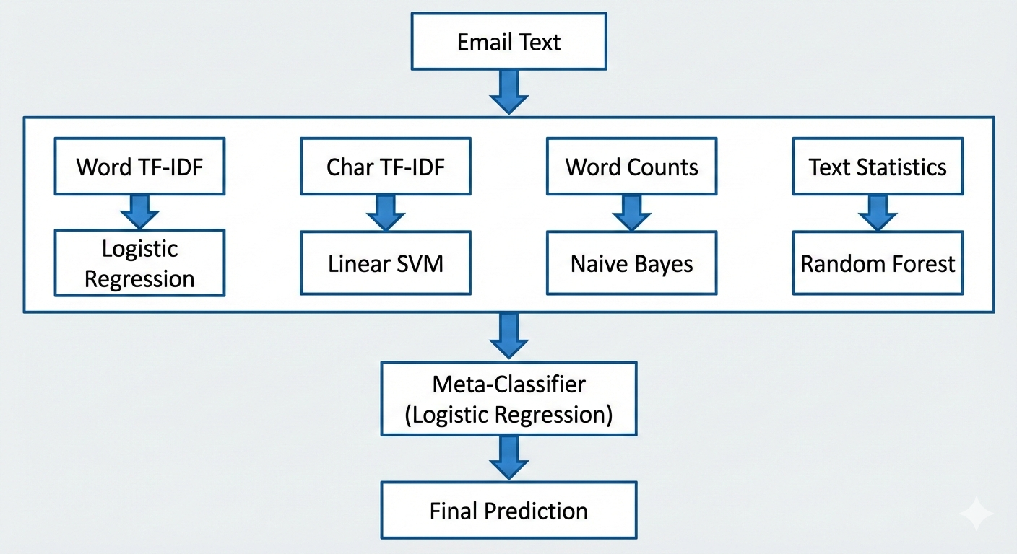

Slide 28
Feature Views
Each view captures a different phishing behavior.
Feature View | Model | What It Detects
Word TF-IDF | Logistic Regression | Suspicious phrases & wording
Character TF-IDF | Linear SVM | Obfuscation & misspellings
Word Counts | Naive Bayes | Frequent phishing terms
Text Statistics | Random Forest | Style patterns (ALL CAPS, links, numbers)

Slide 29
Training & Validation Strategy
Trained on multiple datasets for diversity
Tested on a completely unseen dataset
Uses cross-validation to avoid overfitting
Final model retrained on all data for deployment
Achieved 98.55% accuracy on unseen data

Slide 30
Prototype

Slide 31
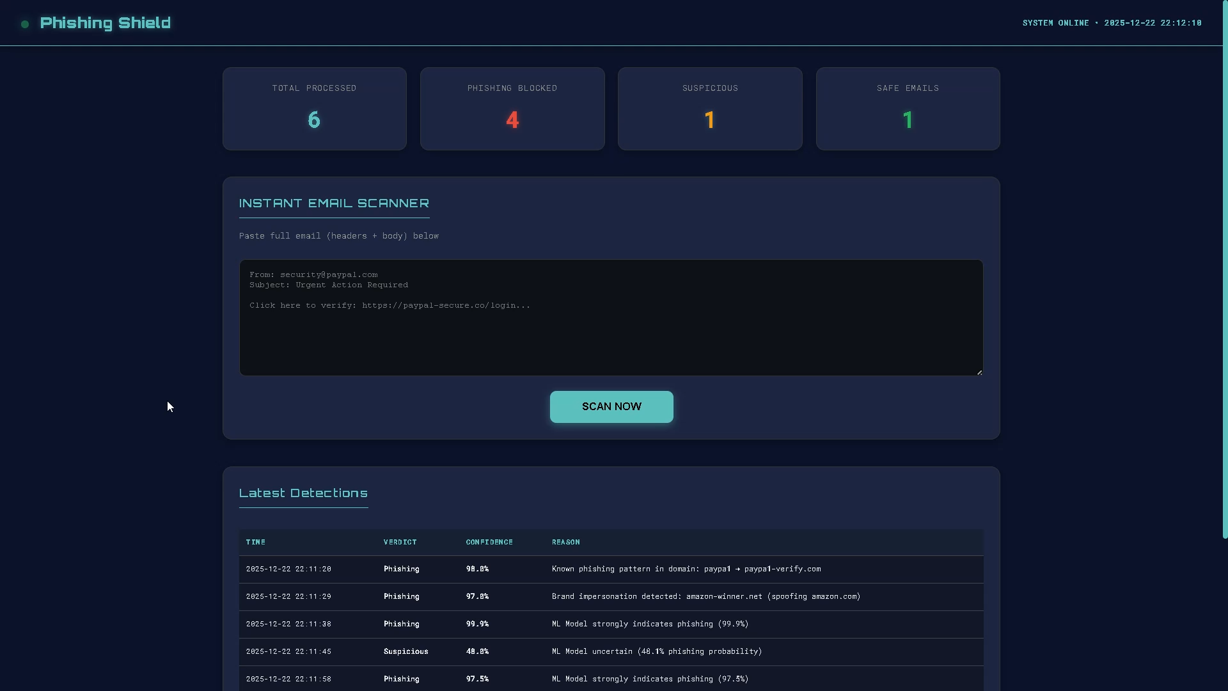
Prototype

Slide 32
Reference
[Reference number]
[Reference number]
[Reference number]

Slide 33
Any Questions?

